Slide 1


Twitter Spam
&
Fraudulent Websites
Kyle Hamilton, Carlos Rodriguez, and Sharmila Velamur

Slide 2
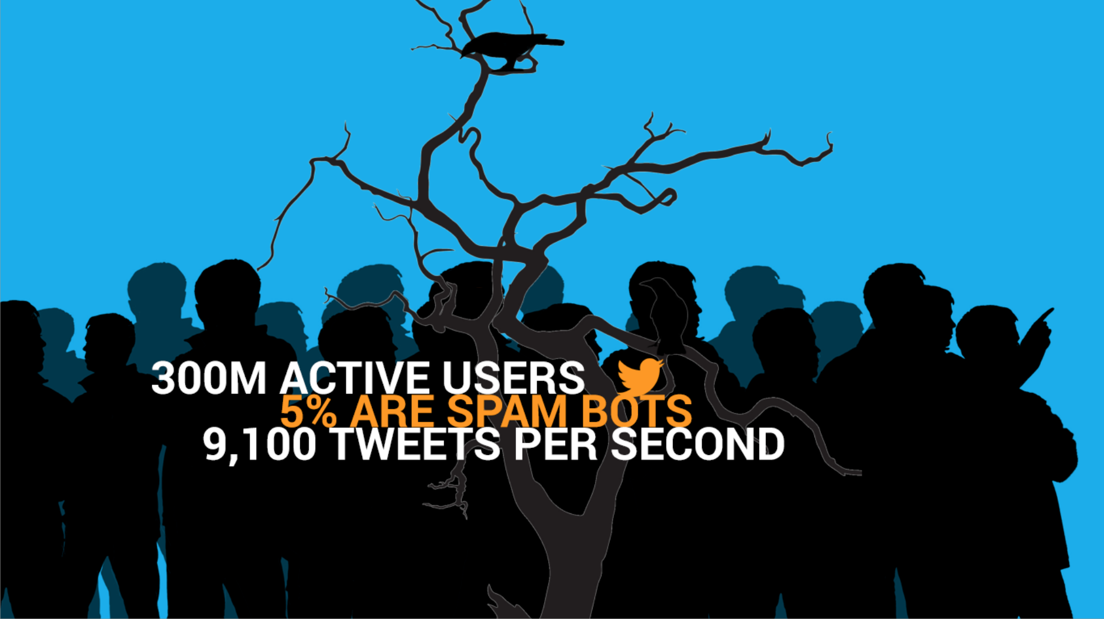
Notes:
Spammers on Twitter, and the URLs they tweet
Social media is a honey-pot for spammer bees; twitter is no exception.
Twitter has close to 300 million active users who send 9100 tweets per second.
Of the 300 million, around 5% are spam bots.
Twitter has its own rules for spamming and these are documented.
Twitter’s stream API allows the public a sneak peek (~1%) of the tweets.
A tweet is a micro-blog that is only 140 characters long, the content of which are text, URLs, hashtags (#) and user-mentions (@).
[http://www.statisticbrain.com/twitter-statistics/]
[http://www.techtimes.com/articles/12840/20140812/twitter-acknowledges-14-percent-users-bots-5-percent-spam-bots.htm]

Slide 3
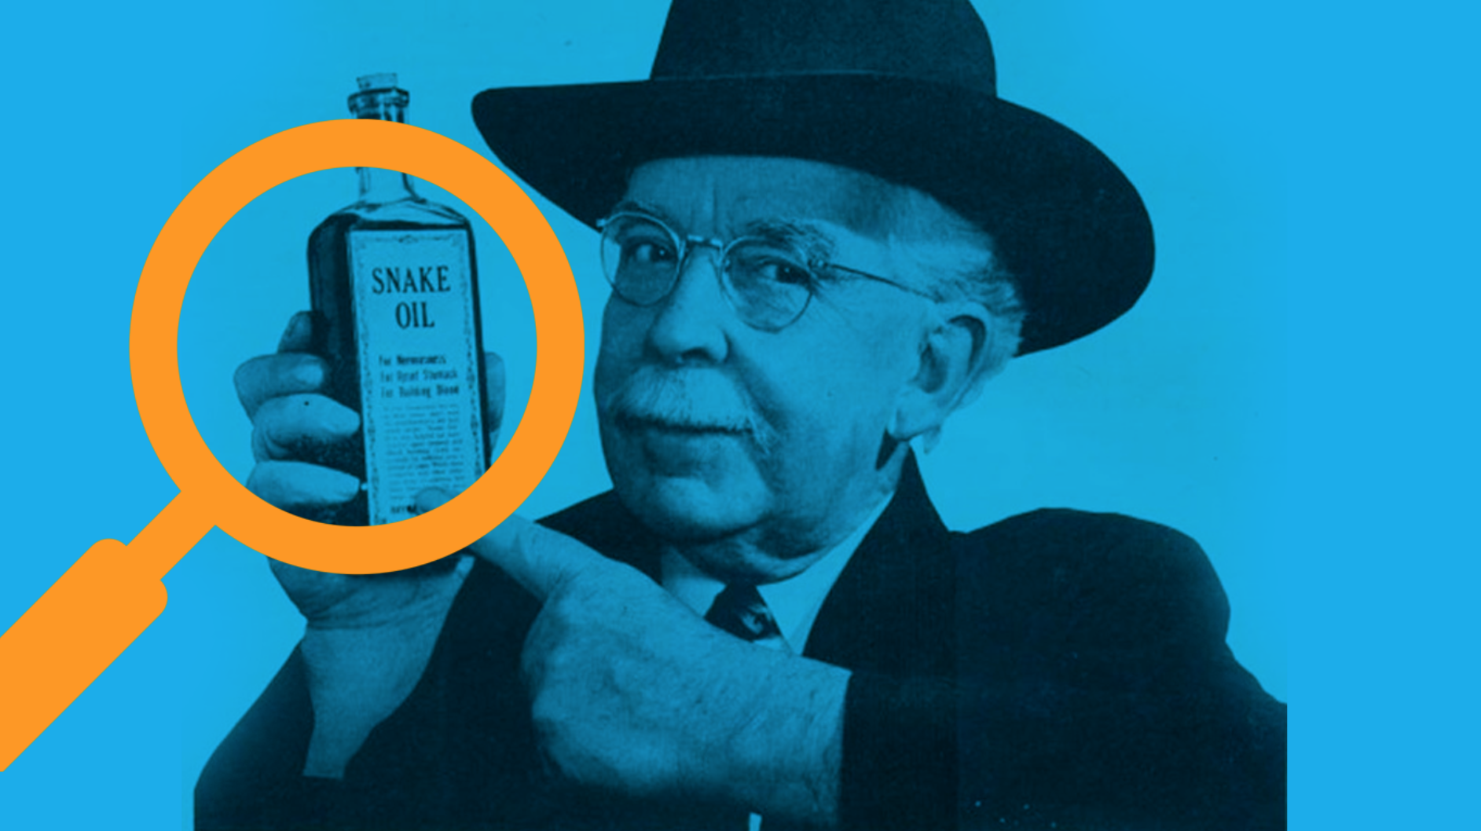
Notes:
The evolution of ideas
How can we successfully identify twitter users generating spam content?
Can we use machine learning algorithms to classify tweets as “spam” or “ham”?
Initial research indicated that user as well as tweet related attributes play a role in spam determination. How we can effectively capture and study the most important feature-set?
Tweeters use shortened URLs. If we classify a tweet as spam, isn’t it highly likely that their URLs are pointing to websites that are fraudulent?
What can we learn by crawling through these suspicious websites?
How can this be used in a greater context?
My idea here, after this slide is to go the very end - show them the plugin and the dashboard. Then explain how we got there and finally show them screenshots or live app (just the dashboard and plugin). This may feel disjointed to you, so we can revise the order and remove TMI as you wish. I added more than necessary as usual I am sure.

Slide 4
Concept stage
Browser Plug-in
Dashboard
Distributed Workflow & Scheduling Coordinator
Data Storing & Retrieval:
Hive,
NoSql (or)
RDBMS
Data Analysis & Precomputation:
Text Analysis
- Scheduled Job
Data Ingestion:
Custom Implementation - Scraping
- Scheduled Job
HDFS - Batch Layer
Notes:
How did we get there?
As a team we decided at the start, two things:
Focus must be on storing, retrieving, and processing data.
Less iterations/optimizations on spam classification is acceptable.
We were flexible and adaptable as the ideas evolved.
We constructed data flow diagrams and architecture diagrams.
We studied the schema of a tweet object.
We read academic papers on tweet spam classification.
We researched industry standards, available platforms, and technologies.
Mostly, we persevered.

Slide 5
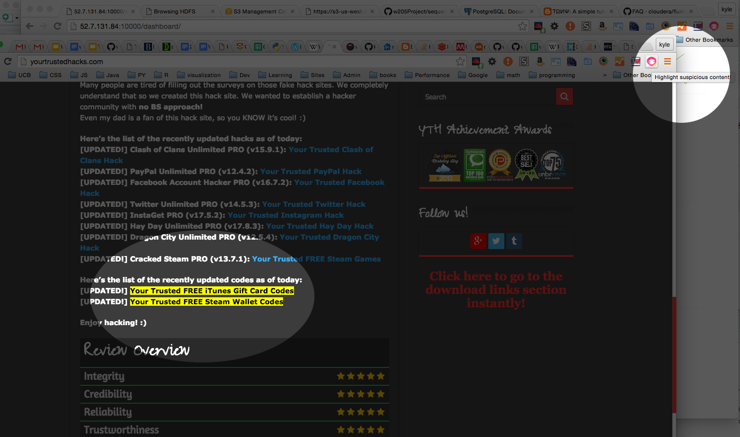
Notes:
Objective:
What is our ultimate objective?
How does this benefit someone in the real world?
Boils down to accessibility and practical application:
Accessibility: visualize insights and patterns
Practicality: serve users on their day-to-day
Alerts users by highlighting suspicious websites on the page they are currently in.
http://yourtrustedhacks.com/
HOW IT WORKS:
The plugin fetches the list of spammy links from S3
Reads all the links on the page and creates lookup table
Does an inner-join on the two sets in O(n) time, where n is the number of spammy links
Highlights any links in the resulting set by applying “highlight” styles to the DOM

Slide 6
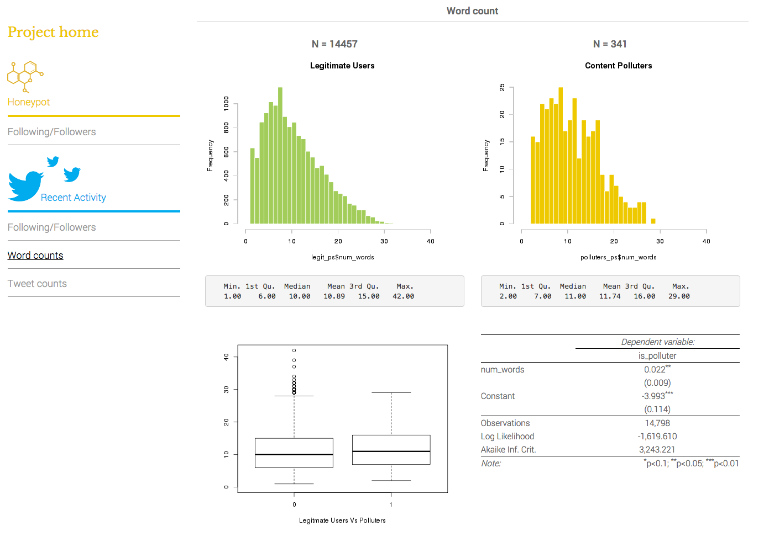
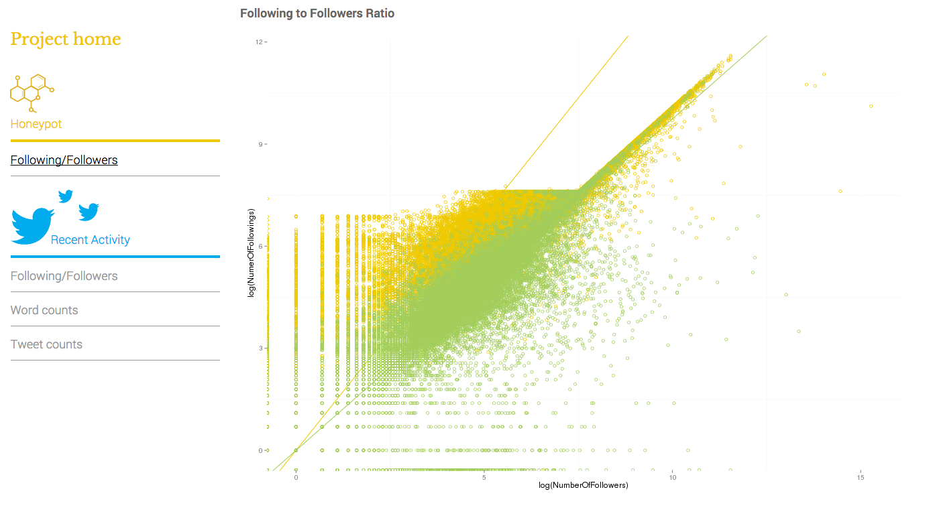
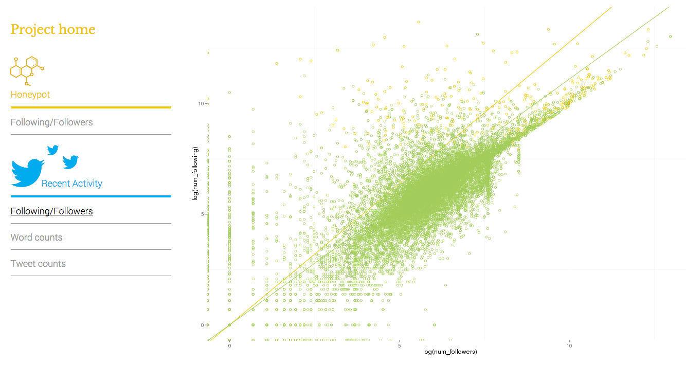
Notes:
Objective (continuation):
Want to answer questions like
What is the makeup of twitter users?
Followers/Following?
Spam versus Ham users?
How about tweets?
What is their makeup (e.g. word-count distributions)
Ultimately, How do we convey insights to users?
Answer: build a dashboard!
Easy way to visually identify patterns patterns at a macro level
Inspect classification model
For example, does spam increase at a certain point of the week or day or month and does it reduce say, during the holidays? (Even spammers need downtime, right?)
Our model produces a ratio of ~3.5% spam, which is not miles away from the accepted 5.

Slide 7


Slide 8
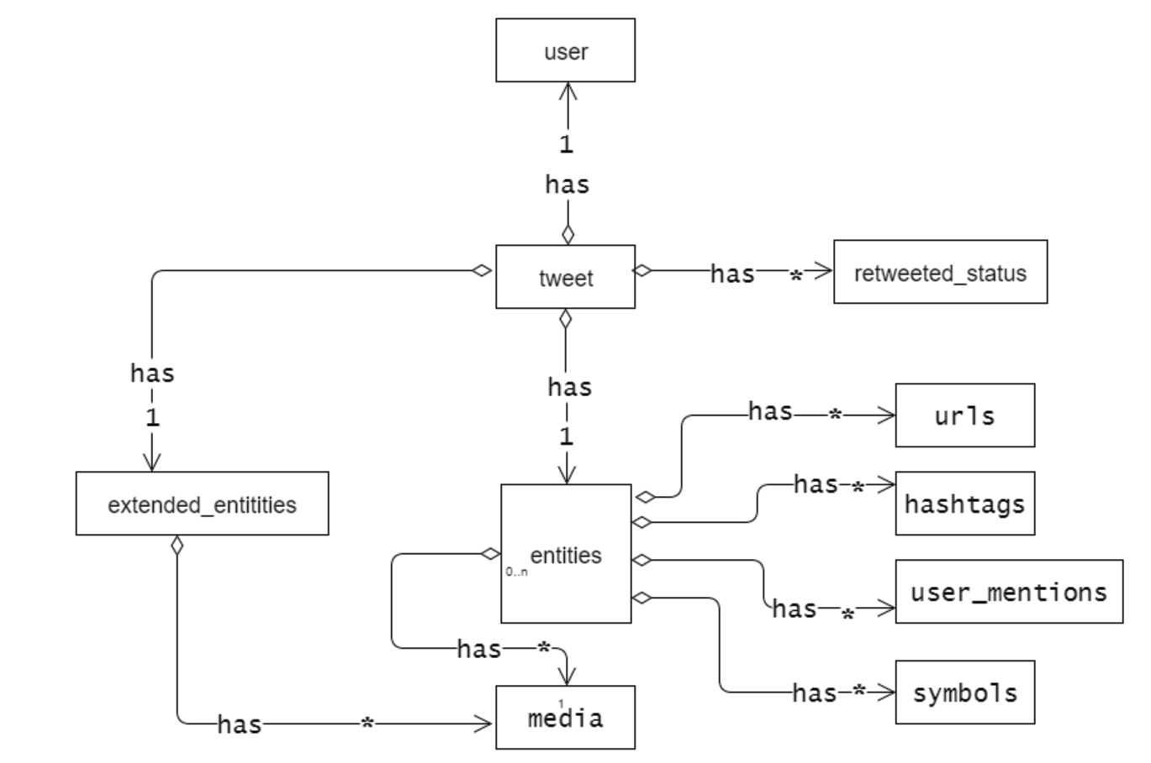
Twitter API
Object-Relationship Model
(Selective & Partial)
Notes:
Twitter API:
Highly complex objects
JSON structure (schema-on-read for our application)

Slide 9
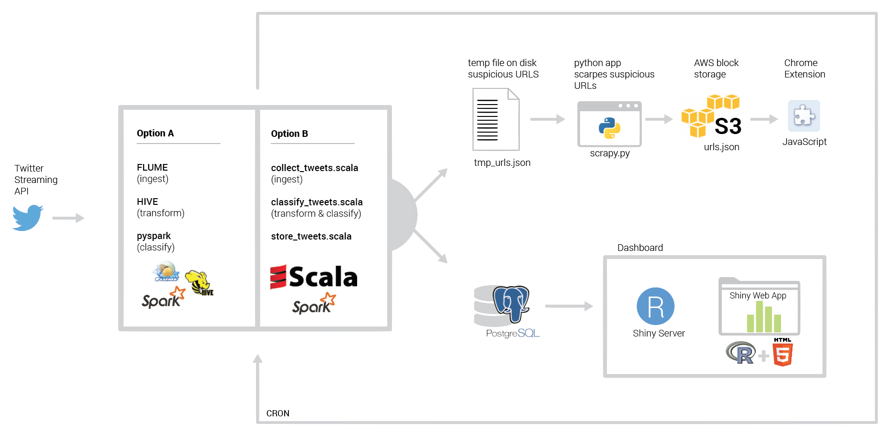
Simple
DATA FLOW
Diagram
Notes:
High level notes on overarching data flows for architecture:
Our setup ended up having a strong basis on the lambda infrastructure (sans speed layer):
Batch layer
Hadoop
Scripts
Serving layer
A) Underlying infrastructure:
Batch layer
Storage (Hadoop): Flume, Hive, Spark (pyspark)
Local (temporary storage)
Scraper: Python
Serving layer
Postgres
Chrome extension: Javascript
B) Underlying infrastructure:
Batch layer
Storage (Hadoop): Spark (Scala), Postgres
Serving layer
Dashboard: Shiny server -> R + HTML5 (backend/delivered from backend)

Slide 10
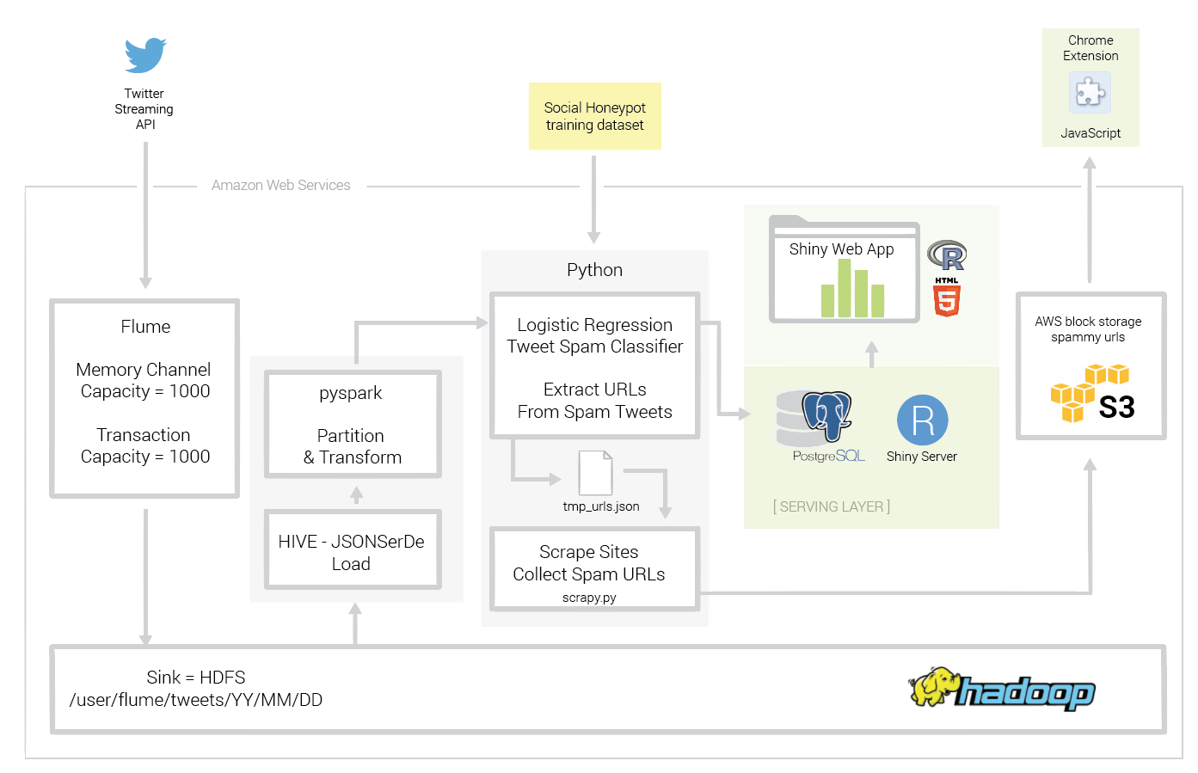
OPTION A
Architecture
Hadoop-HDFS
Flume
Hive
Postgres
Spark-SQL
Spark-Pyspark
S3
Cron
Shiny App (R, HTML5)
Javascript
Notes:
Sub-architecture A (more detailed view):
New data stream (Twitter initially, wider web later)
Batch layer
Data ingestion (Flume): Standard libraries to ingest raw Twitter objects in JSON structure
Storage: Hadoop HDFS (partitioned temporally)
Processing:
Hive (JSON ingestion/deserialization)
Spark (data processing and transforming)
Pythons scripts:
Classification
Reach extension
Serving Layer
Dashboard:
Postgres: classification/visualization data
Shiny Server (R + HTML5): webapp. R was a natural choice for the statistical analysis. Shiny allows for complete control of the User Interface of the app.
The downside of using R is the fact that R does all work in memory, so there is a limit to how much data it can process. To address this, we are taking a random sample of up to 100,000 rows.
Other solutions we considered: Tableau, Zeppelin, D3
Plugin:
S3: url storage. Always available, so our application need not be running for the plugin to remain functional.
Javascript: Chrome Extension
Local (temporary storage)
Serving layer
Scraper: Python
Chrome extension: Javascript

Slide 11
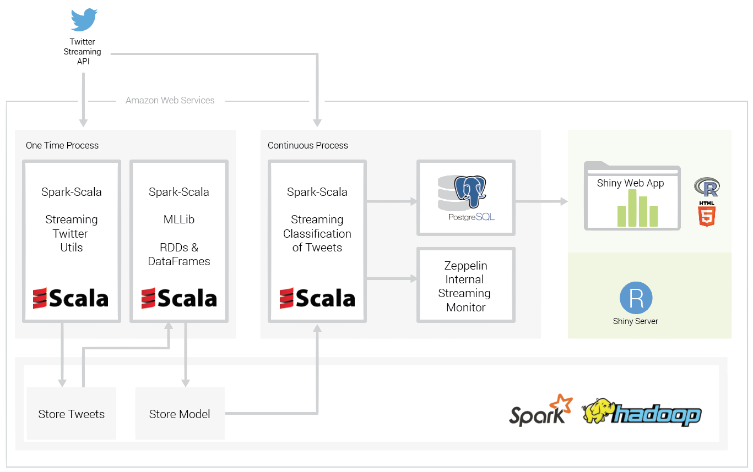
OPTION B
Architecture
Hadoop-HDFS
Spark-Scala
Streaming Lib
Twitter Utils
MLLib/ML
Spark-JDBC
Shiny App
(R, HTML5)
Zeppelin
Optimization:
Spark RDDs
Scala (JVM)
Streaming
Notes:
speed layer

Slide 12
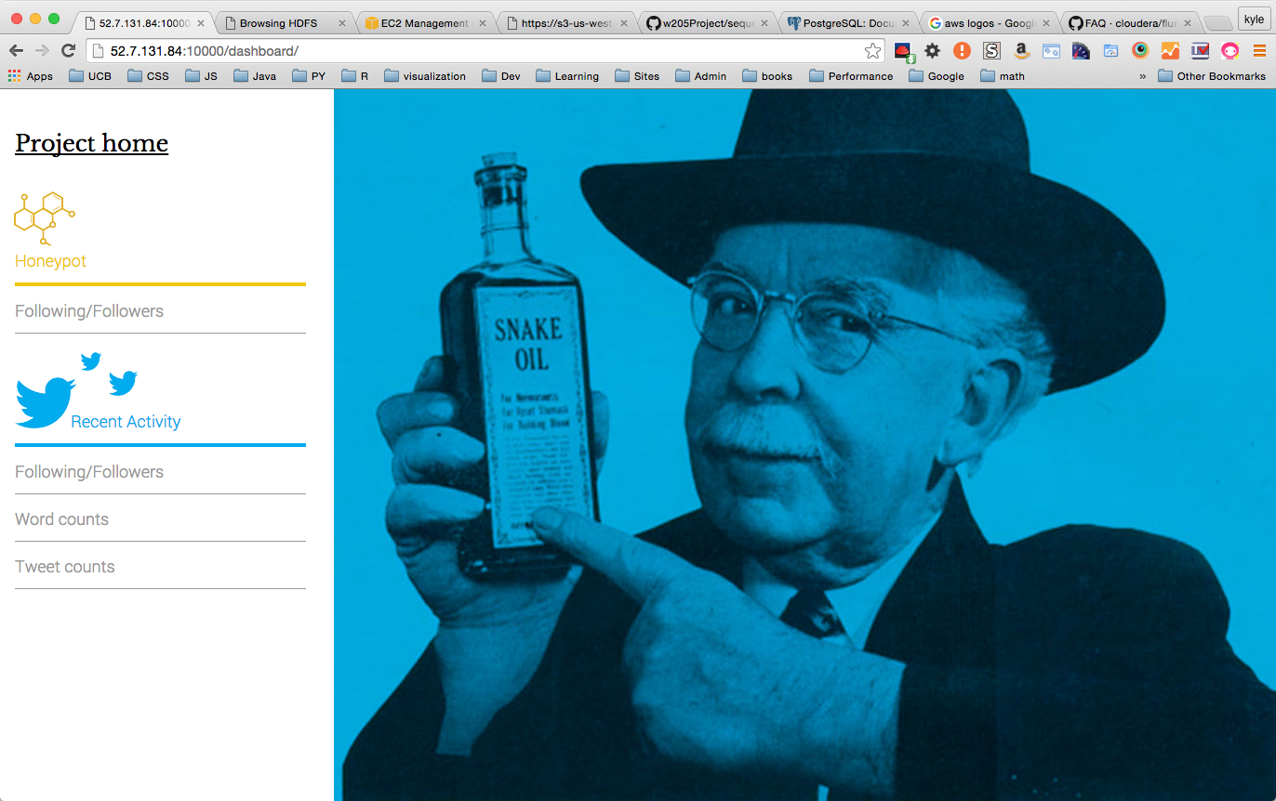

GO-DAWG-GO!
w205Project_V2.0 AMI
wget https://s3-us-west-2.amazonaws.com/w205twitterproject/provision.sh
. provision.sh
. bootstrap.sh
crontab simple_sched_cron.txt
Notes:
Implementation:
Focus on simplicity and speed to implementation
Custom built AMI.
Provisioner script capable of setting up the entire architecture
Cron scripts for workflow scheduling

Slide 13
FUTURE WORK
Clustering and parallelization; using EMR.
Recovering from errors automagically.
Tweaking config such as heap space and other JVM parameters.
RESTful API for dashboard as well as browser plug-in.
Better classification algorithms.
Magnify “spam” URL extension
Utilizing the same data pipeline for multiple areas:
Online marketing - semantic analysis.
Political campaigns - popular topics, alternative polling.
Social experiments on user behavior.
Geolocation based analysis.
Notes:
Take aways from project:

Slide 14


Notes:
There are more than one ways to skin a cat.
Unless the cat skins you first.

Slide 15


